Slide 1
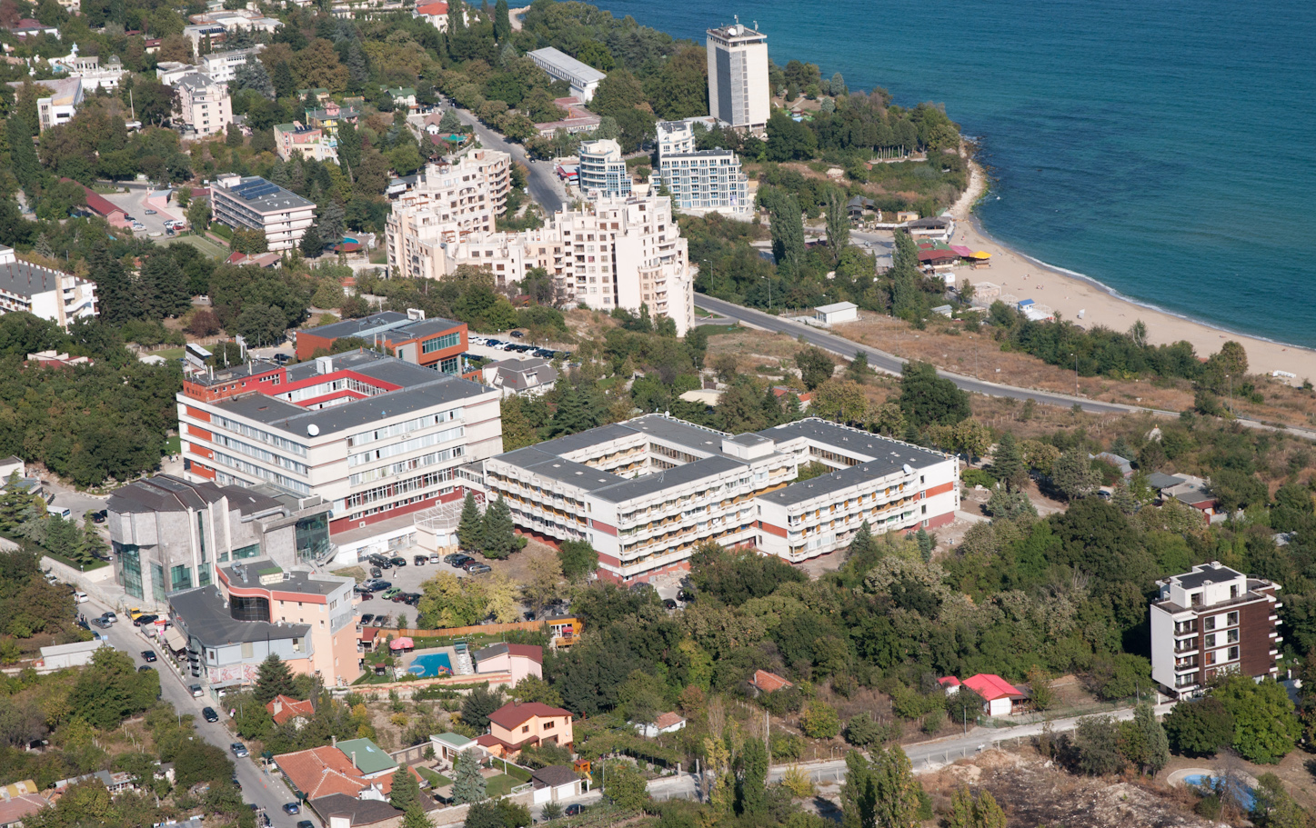
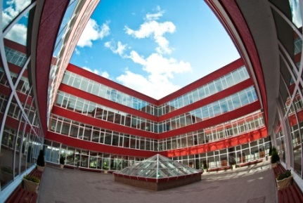
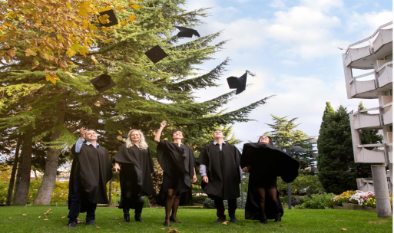
VARNA FREE UNIVERSITY
“CHERNORIZETS HRABAR”
Accredited by NEAA

Slide 2
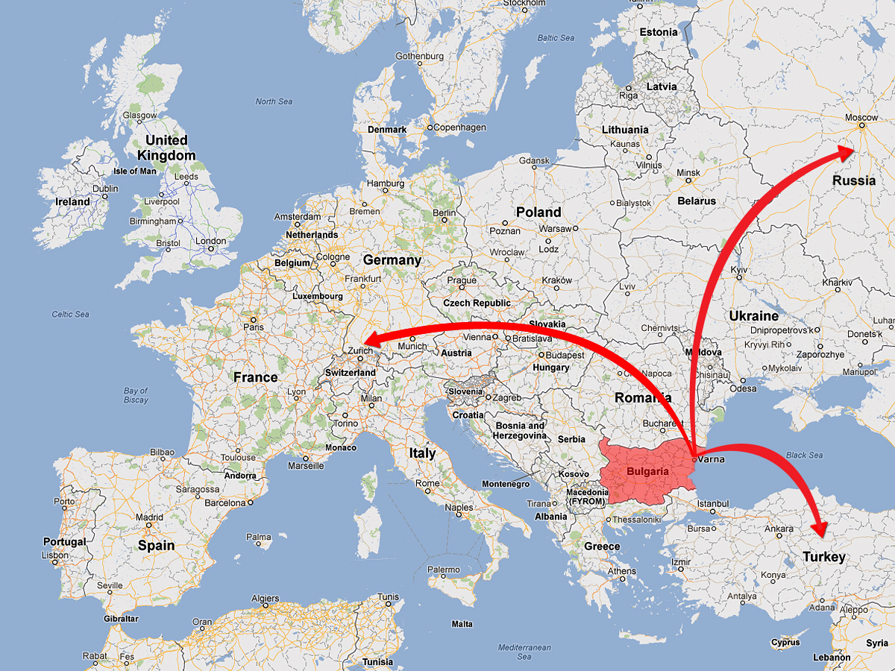

Slide 3
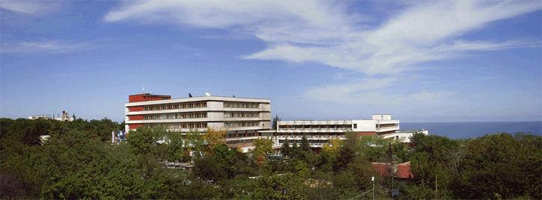
VARNA FREE UNIVERSITY
“CHERNORIZETS HRABAR”
1991 - founded by
“Association Varna Free University”
1995 г. – given the statute of institution of higher education by the 37th National Assembly
National Acreditation: 2001 – Institutional accreditation with the highest grade for a period of 6 years 2006 – Second Institutional accreditation with the highest grade - ‘Very good' for a period of 6 years
2013 – Third Institutional accreditation with the highest grade - ‘Very good' for a period of 6 years

Slide 4
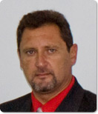
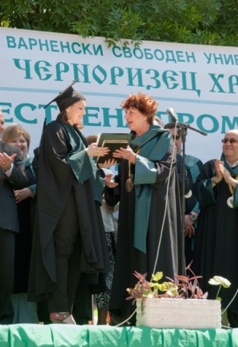
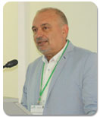
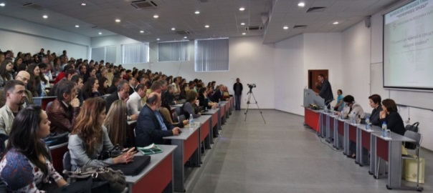
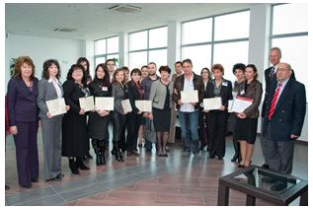
VFU ADVANTAGES (1)
The first non-state university in Bulgaria, established in 1991;
Internationally and nationally accredited with the highest possible marks;
The first and only university in Bulgaria, certified by the European Commission DG "Education and Culture" with DS Label and ECTS Label
Assoc. Prof. Krasimir Nedyalkov, PhD
President
Prof. Petar Hristov, PhD
Rector
HR Excellence in Research Logo awarded by the European Commission

Slide 5
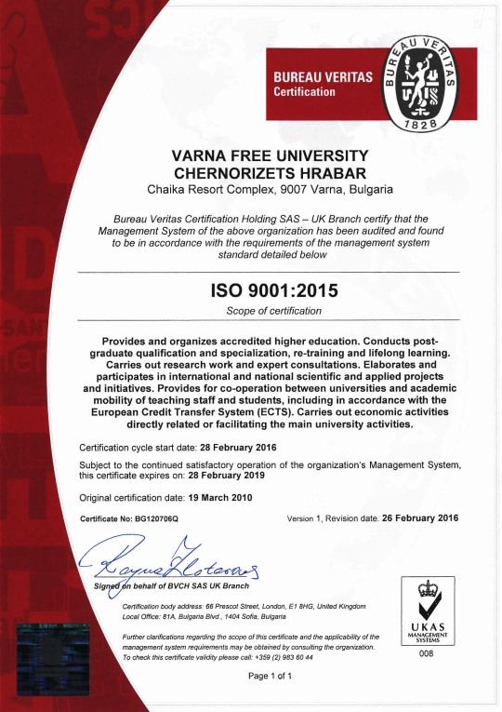
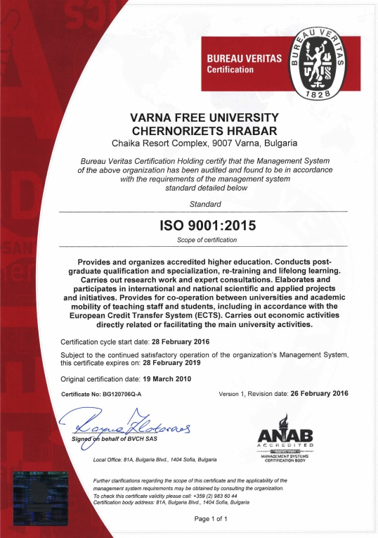
VFU ADVANTAGES (2)
History
Recertified to the international standard ISO:
2001 – ISO 9001:1994
2004 – ISO 9001:2000
2007 – ISO 9001:2000
2010 – ISO 9001:2008
2016 – ISO 9001 :2015
The university has been recertified to the International Standard ISO 9001:2015 and obtains certificates from UKAS (Great Britain) and ANAB (the USA), substituting national certificates with generally accepted international ones.
2009 – Award of DS LABEL
2010 – Award of ECTS LABEL
2012 – Award of HR Excellence in Research Logo
2013 – Award of DS LABEL
2013 – Award of ECTS LABEL
2015 – Award of HR Excellence in Research Logo

Slide 6
VARNA FREE UNIVERSITY “CHERNORIZETS HRABAR”
VFU ADVANTAGES (3)
DS Labels are awarded to institutions providing European Diploma Supplements to B.A. and M.A. graduates in conformity with the standards established by the European Commission, the Council of Europe and UNESCO.
It provides opportunities for easier qualification recognition by universities and employers in foreign countries – a requisite for a successful career start.
The ECTS Label is awarded to institutions with significant success in applying the European Credit Transfer and Accumulation System (ECTS) in Educational–and-qualification degrees: Bachelor and Master.
It gives the awarded institution greater prestige, making it a dependable and trustworthy partner in European and international cooperation.

Slide 7
VFU ADVANTAGES (5)
VARNA FREE UNIVERSITY “CHERNORIZETS HRABAR”
The HR Excellence in Research Logo is awarded to institutions for excellence in scientific research. The label is legitimation of research freedom, professional responsibility for staffing, international recognition of their qualifications, public responsibility and commitment to research topics and projects with the business sector and the interests of local communities.
Learn more about the certificates of the university on:
https://www.vfu.bg/the-university/ects-ds-labels-2.html
Learn more about the university accreditation on:
https://www.vfu.bg/the-university/accreditation-2.html

Slide 8
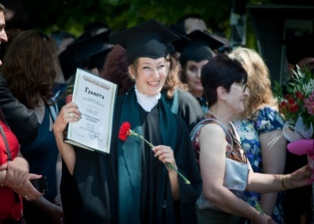
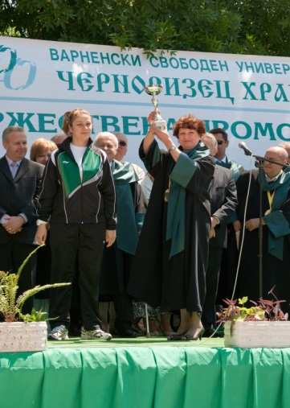
VFU ADVANTAGES (6)
VARNA FREE UNIVERSITY “CHERNORIZETS HRABAR”
High-quality European education;
A modern and cutting-edge campus just metres from the sea;
International academic environment;
A number of exchange programmes, work placements and internships in Bulgaria and abroad;
A diversity of auxiliary courses;
Education funding programmes;
Programmes encouraging the development of students in the field of culture, science, art and sport;
A diploma recognised throughout the EU and the world;
Global opportunities for career development.

Slide 9
VARNA FREE UNIVERSITY “CHERNORIZETS HRABAR”
THE MISSION
Sustainability of the quality
of the educational and
research work and
university management
Research and highly
technological type
of university
Flexible and adaptive
to the dynamics of labour
market and the needs of
the society
Responsible for the
permanent
implementation of
the “total quality”
philosophy
Private higher education -
21st century model
Oriented towards students
and their professional
suitability
Competitive around
the world and in the
European educational
space
With highly qualified and
internationally convertible
academic staff
European standards in educational process and Lifelong Learning

Slide 10
VARNA FREE UNIVERSITY “CHERNORIZETS HRABAR”
THE NEW PARADIGM
Transdisciplinarity in curriculum
Commitment with business
and labour market
necessities
Integration of research
and training
Global challenges in education and research
“New skills
for new jobs”
Internationalization
Mobility of
ECTS credits

Slide 11
VFU’s Growth Strategy
VARNA FREE UNIVERSITY “CHERNORIZETS HRABAR”
E-WORKING
RESEARCH-BASED TRAINING
BUSINESS COOPERATION
;
INTERNATIONALIZATION
SUSTAINABLE DEVELOPMENT
Application
of
New Technologies

Slide 12
Internationalization
- training of foreign students; - export of educational product; - academic exchange;
Research-Based Training
- PBL (Problem and Project-Based Learning); - inquiry-based learning & exemplary learning; - technology transfer; - collaborative research;
Strategic Framework
for
Cooperation
in
Education & Training
Business Cooperation
- board of trustees; - practices & traineeships; - company training; - training on demand;
New Technologies
- online learning;
- mobile learning; - cloud technologies;
- social media tools;
- networking;

Slide 13
Research Areas
Innovation and Тechnology Transfer
Black Sea Region
Information Technologies
Sustainable Architecture
Tourism
Psychology
Science and Society
Business and
Law
Security and Defence

Slide 14
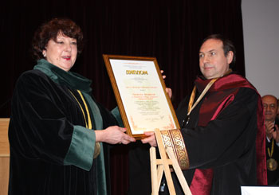
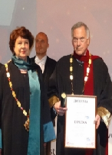
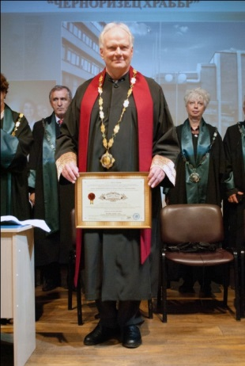
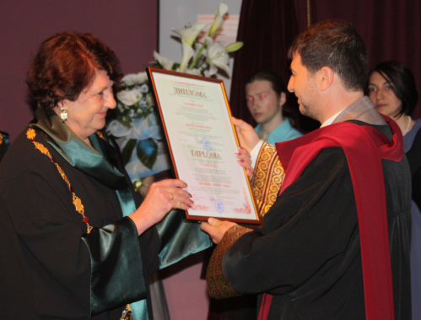
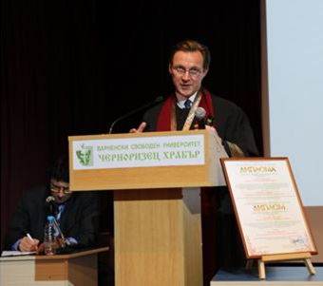
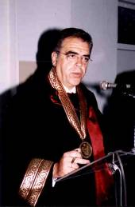
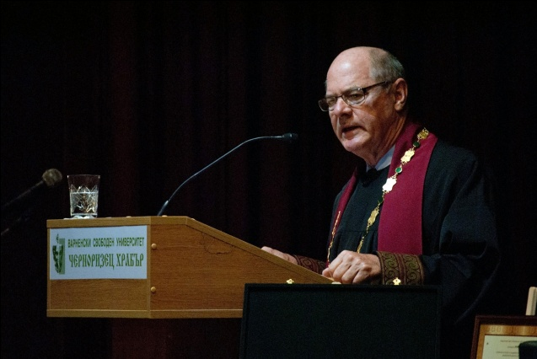
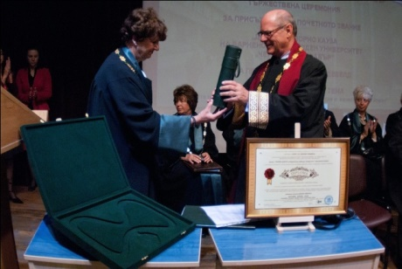
VARNA FREE UNIVERSITY “CHERNORIZETS HRABAR”
Mr. Terry Davis
Doctor Honoris Causa of VFU
V.A. Nikonov
Honorary Professor of VFU
Prof. Ulrich Beck –
Doctor Honoris Causa
of VFU
Prof. Steve Hanke–
Doctor Honoris Causa
of VFU
Plamen Rusev –
Doctor Honoris Causa
of VFU
Al.A. Gromiko
Honorary Professor of VFU
Prof. George Vredeveld
Doctor Honoris Causa of VFU
Ambassador
Dimitris Kourkoulas
First Doctor Honoris Causa of VFU
Academic Yuhnovski
Doctor Honoris Causa of VFU

Slide 15
BOARD OF TRUSTEES
PRESIDENT OF VFU
Chair of the board of Trustees
VICE PRESIDENT
ACADEMIC COUNCIL
ACADEMIC BOARD
RECTOR
VICE-RECTOR
VICE-RECTOR
VICE-RECTOR
ASSISTANT RECTOR
FACULTIES
Technology Institute
International Economics and Administration
Faculty of Law
Faculty of Architecture
Foreign Language Teaching Department
Department of Computer Science
Smolyan Branch
Department of Legal Sciences
Department of Architecture and Urban Studies
Department of Administration, Management and Political Science
Institute for Integrated Management of Municipalities
Department of Psychology
Construction of Buildings and Facilities Department
Department of Security and Safety
PhD Institute
Department of Economics
Department of Arts

Slide 16
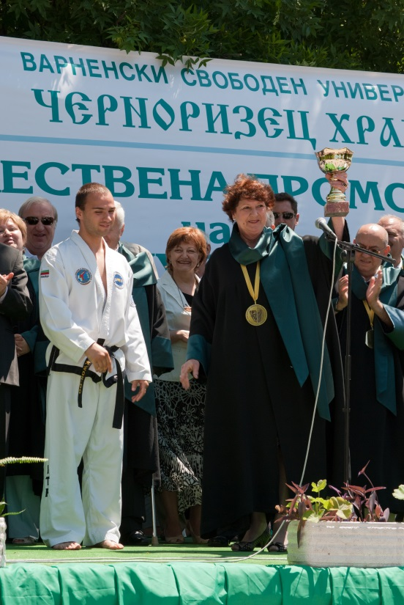
ACADEMIC PROFILE
VARNA FREE UNIVERSITY “CHERNORIZETS HRABAR”
21 BA, 64 MA and 23 PhD programmes
Full-time, part-time and distance modes

Slide 17
ACCREDITED FIELDS AND SPECIALITIES
PhD
23
Postgraduate
64
9
Bachelor
21
FIELD
Research
PRACTICE
LIFE
LEARNING
LONG
THE TREE OF TRAINING

Slide 18
ACADEMIC PROFILE
VARNA FREE UNIVERSITY “CHERNORIZETS HRABAR”
FACULTIES
DEPARTMENTS
SPECIALITIES
INTERNATIONAL
ECONOMICS AND
ADMINISTRATION
ADMINISTRATION, MANAGEMENT
AND POLITICAL SICENCE
BUSINESS ADMINISTRATION
PUBLIC ADMINISTRATION
INTERNATIONAL RELATIONS
INTERNATIONAL ECONOMIC RELATIONS
INTERNATIONAL MARKETING
FINANCE AND ACCOUNTING
COMPUTER SCIENCE AND ECONOMICS
COMPUTER STUDIES
LEGAL SCIENCES
LAW
FACULTY OF LAW
PSYCHOLOGY
PSYCHOLOGY
SECURITY AND PROTECTION
NATIONAL SECURITY PROTECTION,
CRIME PREVENTION AND PUBLIC ORDER PROTECTION
ARCHITECTURE AND URBANISM
ARCHITECTURE
DESIGN
FACULTY OF ARCHITECTURE
CONSTRUCTION OF BUILDINGS
AND INSTALLATIONS
CONSTRUCTION ENGINEERING FIRE SAFETY AND POPULATION PROTECTION
ARTS
FASHION AND FASHION MANAGEMENT FINE ARTS

Slide 19
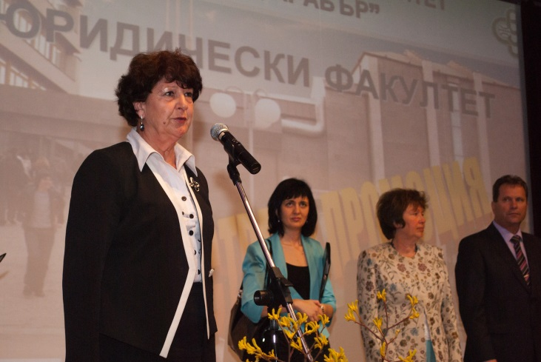
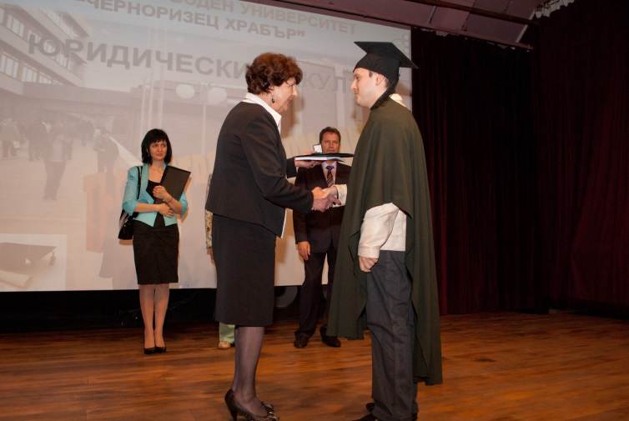
STUDENT PROFILE
VARNA FREE UNIVERSITY “CHERNORIZETS HRABAR”
12,000 current students from 22 different countries;
30,334 former graduates;
2,000 students with scholarships or receiving financial incentives to cover up to 100% of their semester fee;
400 students having participated in student mobility, work placements and internships abroad.

Slide 20
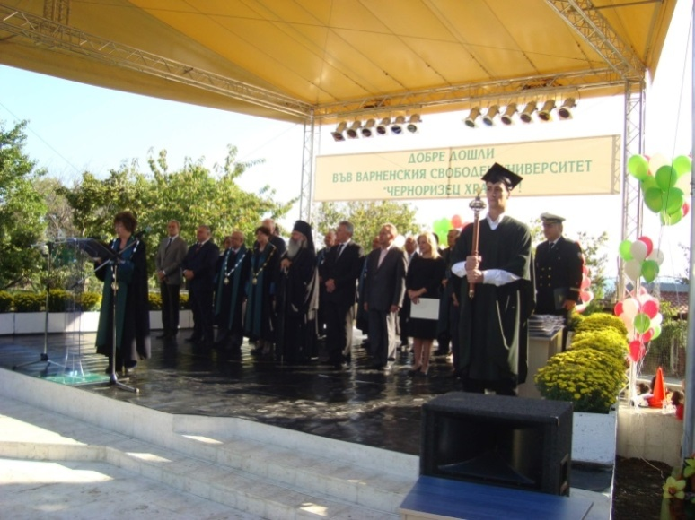
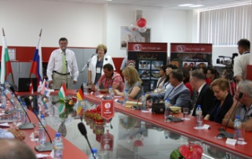
VARNA FREE UNIVERSITY “CHERNORIZETS HRABAR”
Training at VFU (1)
Social, economic and legal sciences
900 lecturers and experts in over 50 areas of science
Natural sciences and Computer Studies
VFU AREAS OF HIGHER EDUCATION
Technical sciences
Arts
Security and protection

Slide 21
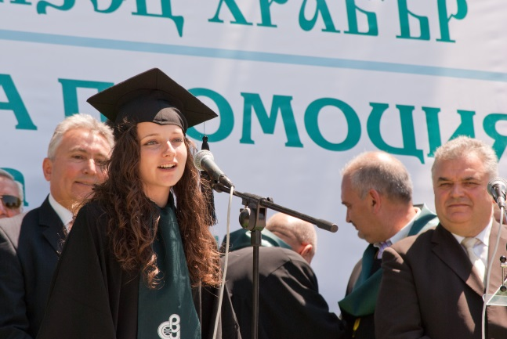
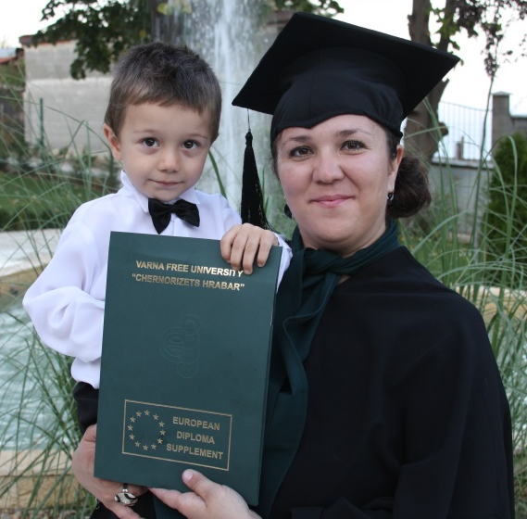
Training at VFU (2)
VARNA FREE UNIVERSITY “CHERNORIZETS HRABAR”
we have one of the best campuses in Bulgaria and many of our lecturers are considered leading experts in their field both nationally and internationally;
recognized in Bulgaria and the European Union qualification and skills needed by each employer. The University is institutionally accredited by the National Agency for Quality Assessment and Accreditation at the Council of Ministers of Bulgaria with the maximum score and for the maximum possible period.

Slide 22
Belgium
France
Portugal
Great Britain
Sweden
Morocco
Germany
Austria
Spain
International contacts
More than 540 partners from 50 countries
Stockholm
Swedish Defence University
Oslo
BI Norwegian Business School
Coventry University Enterprises Ltd.
University of Cincinnati
Universita IUAV di Venezia
Aristotle University of
Thessaloniki, Greece
CBC
Universita degli Studi di Siena
University of Trento
Management
Computer Technologies
Ben-Gurion University
Royal Academy of Fine Arts - Antwerpen
PMK
Building and designing consortium - Austria
VARNA FREE UNIVERSITY
London
Economics and
Management
VSB- Technika Univerzita Ostrava
University of Salford
UPBEAT Benchmarking Project
Association of
Private Higher Education
Institutions
Cambridge
European Law
Strasbourg
Risk prevention and management under crises and calamities conditions
Black Sea Universities Network (BSUN)
Barcelona
Entrepreneurship and management of the small and medium sized enterprises
Oxford
International Tourism Management
European University Association
University of Zilina
Russia
Poland
Israel
Italy
USA
China
Turkey
Romania
Greece
Norway

Slide 23
VARNA FREE UNIVERSITY “CHERNORIZETS HRABAR”
European programs 2018-2020
ERASMUS PLUS (2018-2020)
Structural Funds 2018-2020
Danube Transnational Programme
Norway Grants
CBC Black Sea Basin Programme
COST Programme
Interreg Europe

Slide 24
ERASMUS MOBILITY PARTNER UNIVERSITIES
Haute Ecole Libre Mosane (HELMO)
VŠB-Technická Univerzita Ostrava
University College of International and Public Relations Prague
Brandenburg University of Techology Cottbus-Senftenberg (BTU)
TH Köln - University of Applied Sciences
Athens University of Economics and Business
University of the Aegean
Universidad de Almeria
Univesidad de Granada
Universidade da Coruña
Universidad de Zaragoza
Ecole Des Dirigeants et Createurs d'Entreprise
Institut d'Etudes Politiques de Grenoble
Ecole National Superior D'Architecture de Toulouse
Budapest Metropolitan University of Applied Sciences
Obuda University
Universita degli Studi di Modena
Politecnico di Milano
Second University of Naples
Universita degli Studi di Siena
Universita degli Studi di Trento
Universita IUAV di Venezia
Klaipeda State College

Slide 25
ERASMUS MOBILITY PARTNER UNIVERSITIES
Riga Building College
Universidade Portucalense Infante D. Henrique
Instituto Politecnico de Santarem
Stanislaw Staszic School of Public Administration in Bialystok
University of Lodz
Lodz University of Technology
University of Humanities and Economics in Lodz
National Defence University
University of Wroclaw
The General Tadeusz Kościuszko Military Academy of Land Forces
Katolicki Uniwersytet Lubelski Jana Pawla II
Technical University of Cluj-Napoca
University of Bucharest
University of Zilina
NİŞANTAŞI UNIVERSITY
Maltepe University
Trakya University
Namik Kemal University
University of Bolton
South East European University
Hogskolen i Ostfold
Zagreb School of Economics and Management
Information Systems Management Institute
Riga Building College

Slide 26
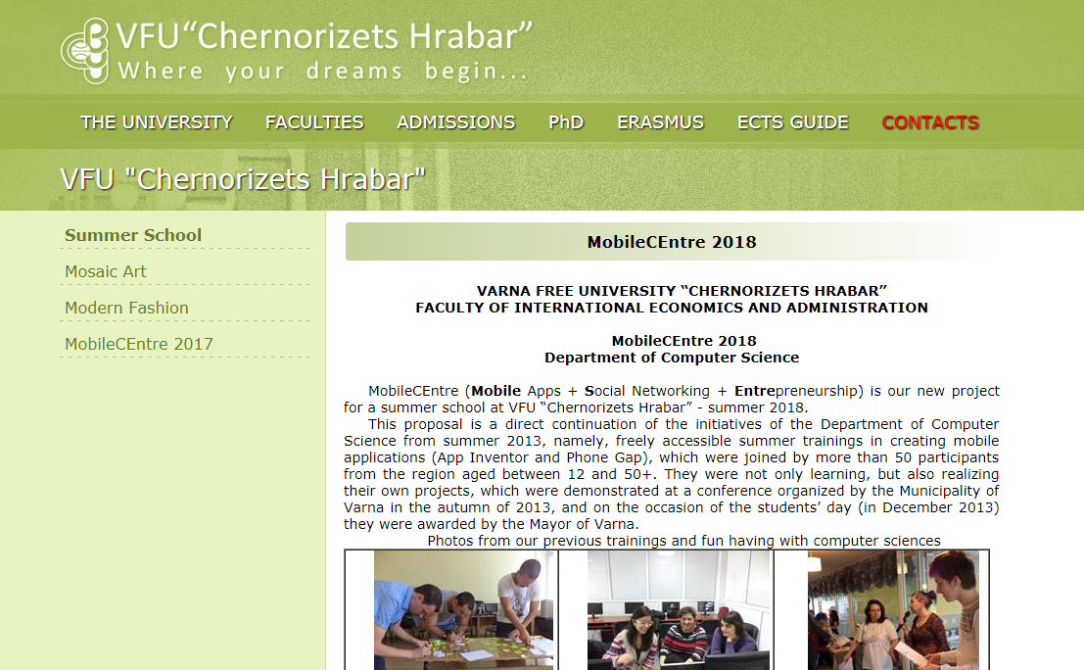
Summer Schools

Slide 27
VARNA FREE UNIVERSITY “CHERNORIZETS HRABAR”
VFU PROJECTS
THE EUROPEAN BUSINESS –
GUARANTEE FOR THE PROFESSIONAL APTITUDE OF THE HIGHER EDUCATION GRADUATES AT VARNA FREE UNIVERSITY “CHERNORIZETS HRABAR”
BLACK SEA
ACADEMIC ASSOCIATION
SMART FUTURE
BLACK SEA
ACADEMIC NETWORKS
International Academy
“Knowledge and Innovations”
Experts and Students -
Partnership for
Competitiveness
EUROPEAN CLUSTER OF KNOWLEDGE AND SCIENTIFIC RESEARCH FOR SUSTAINABLE DEVELOPMENT
ACADEMIC ENTREPRENEURSHIP IN TOURISM
Academic Park
2020
Academy for Leaders -
with GRID International
STREAMED EDUCATION

Slide 28
VARNA FREE UNIVERSITY “CHERNORIZETS HRABAR”
Joint educational
programs &
Double diplomas
Seminars, Workshops & Conferences;
Company training
Research & Development
projects
Online Learning;
Cloud Technologies
Cross-Border Collaboration
Internationalization
Students’ Exchange
International content
in the curriculum
Branch Campuses
INTERNATIONALIZATION –
to cope with the global academic environment

Slide 29
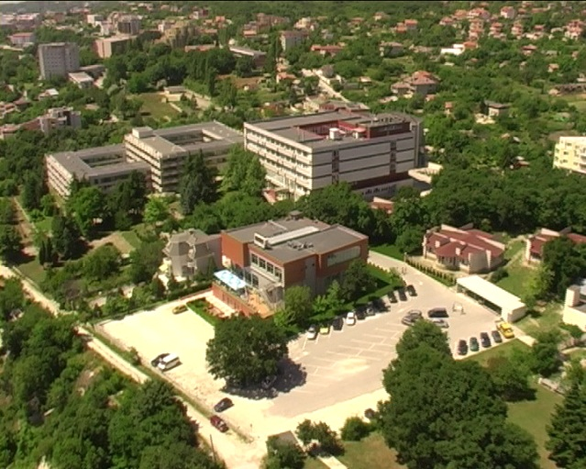
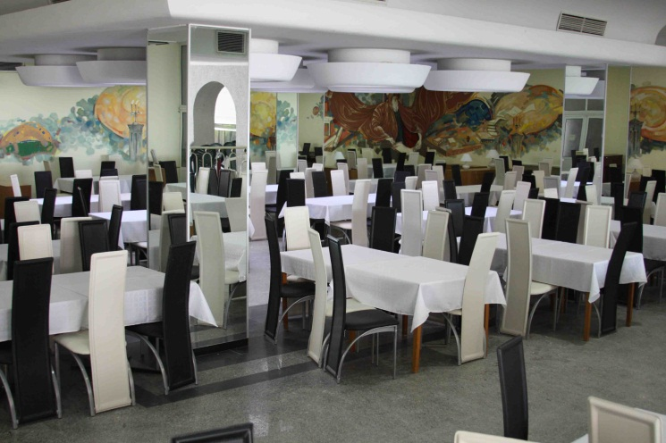
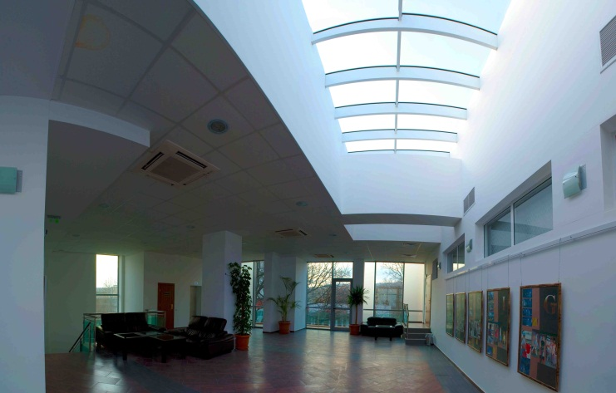
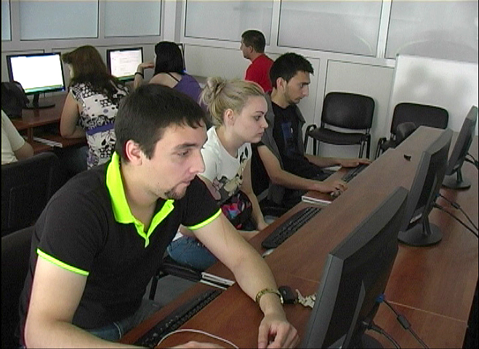
VARNA FREE UNIVERSITY “CHERNORIZETS HRABAR”
VFU CAMPUS

Slide 30
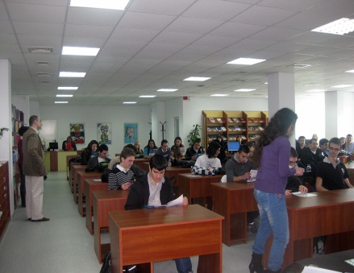
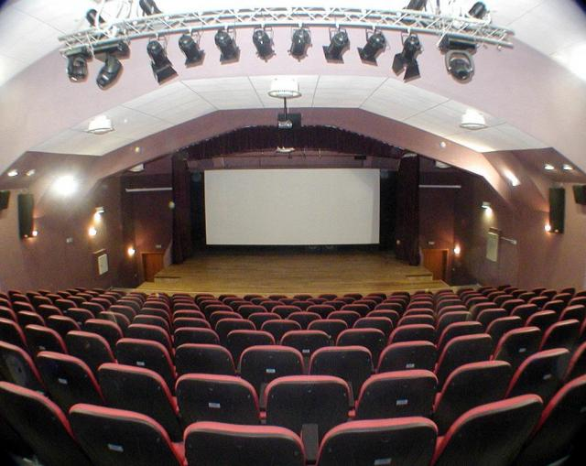
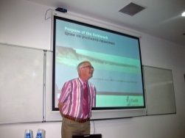
VARNA FREE UNIVERSITY “CHERNORIZETS HRABAR”
INSTITUTE OF TECHNOLOGY
ELECTRONIC LIBRARY
Data base server with E-books and manuals
Digital Library-Educational Complex
Presentation Center
Electronic reading-room
Electronic reading- room
Specialized reading-room
The “Maxima” hall
Publishing house
Electronic reading- room
Specialized rooms
Court room
Foreign language
teaching lab

Slide 31
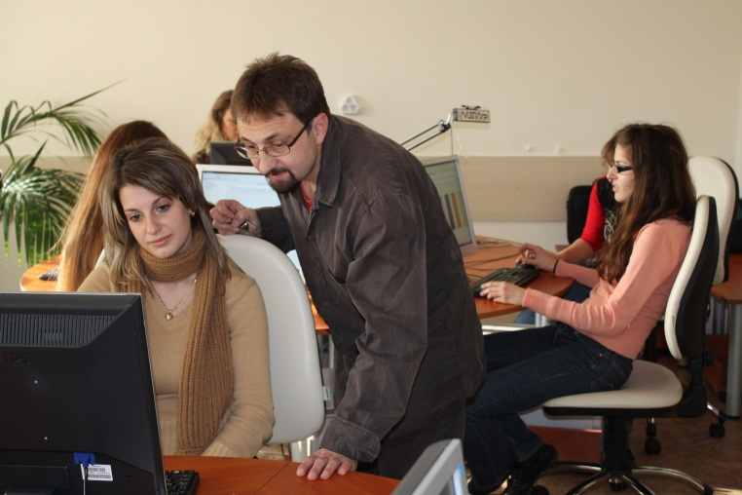
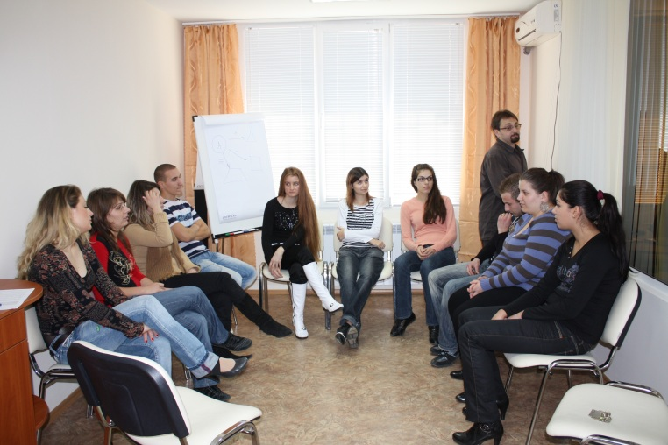
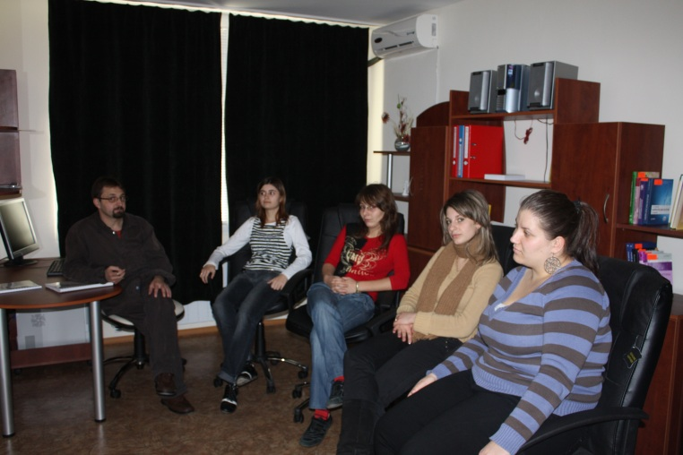
University Medical - Psychological Complex
VARNA FREE UNIVERSITY “CHERNORIZETS HRABAR”
Office for physiological tests
Interactive hall for developing the communicative skills and video training
Office for psychological consulting and psychotherapy

Slide 32
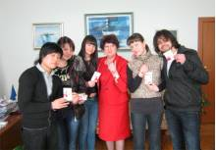
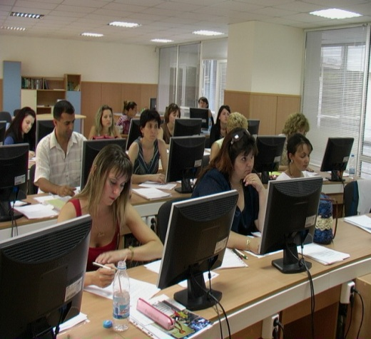
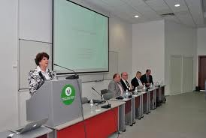
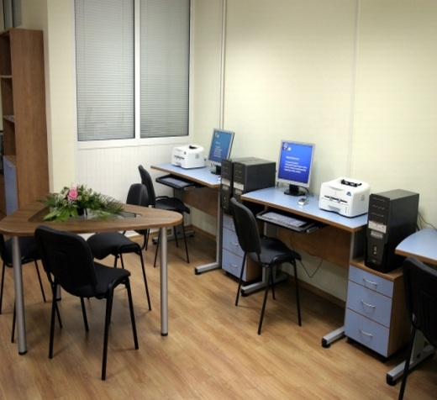
VARNA FREE UNIVERSITY “CHERNORIZETS HRABAR”
Training Accounting
Office
Euro qualification Centre at VFU
Euroqualification Center
Foreign Language
Teaching and
Certification Center
Student Business Incubator
The conference room
of the Euroqualification Center

Slide 33
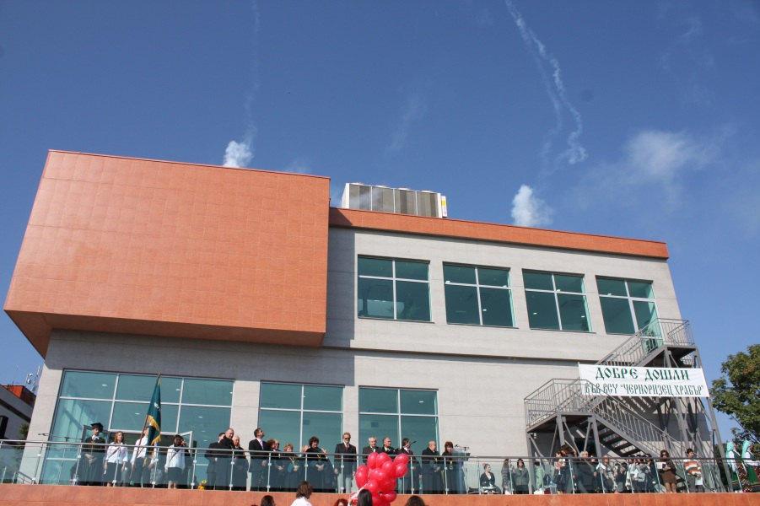
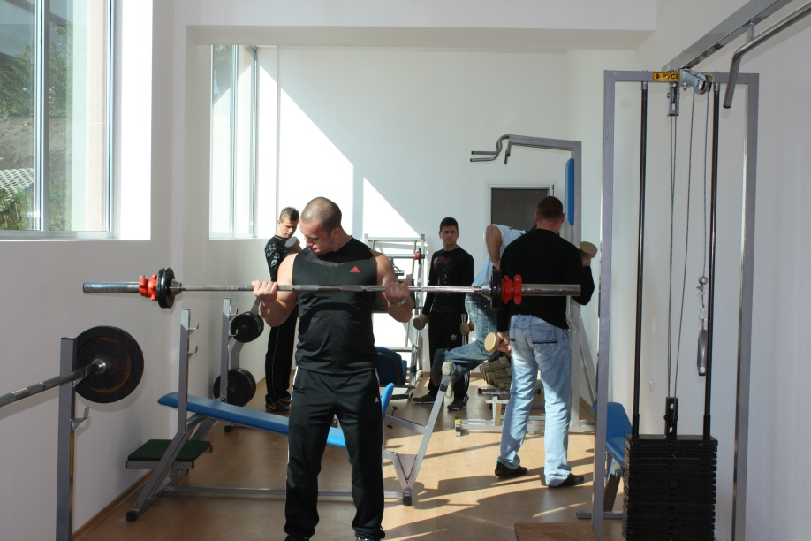
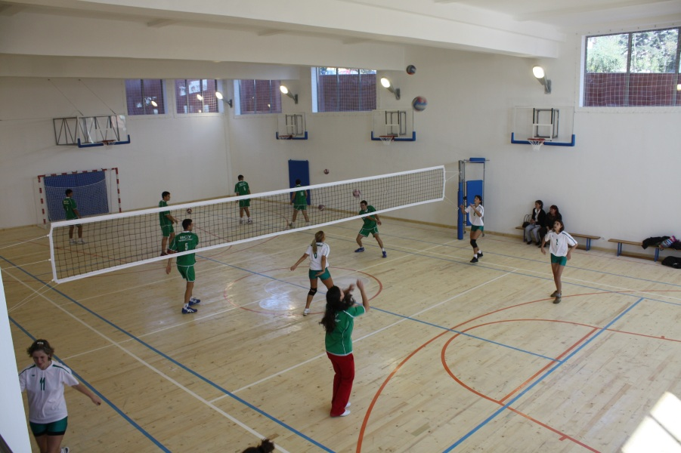
Educational and Sport complex
VARNA FREE UNIVERSITY “CHERNORIZETS HRABAR”
Three study rooms with 483 student seats
Multifunctional sports hall where
Basketball, Futsal, Table tennis, etc. competitions can take place
Gym
Free access for students 8 – 20 h.
The educational and sport complex is fully air-conditioned, with a lift and is provided with all utilities for disabled people.

Slide 34
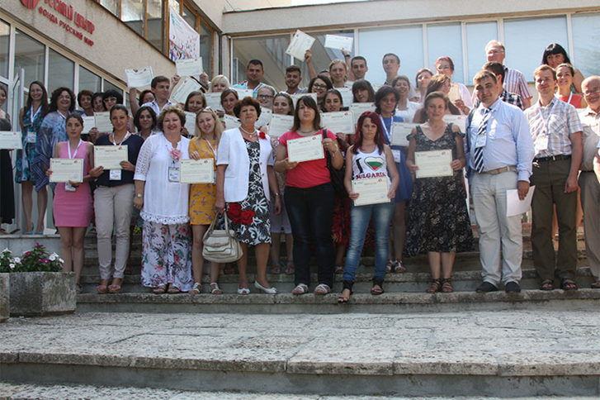
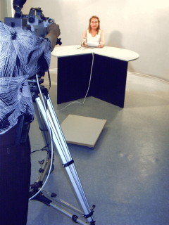
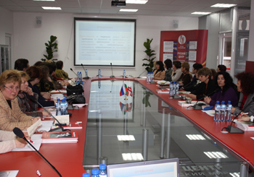
University Media Center
VARNA FREE UNIVERSITY “CHERNORIZETS HRABAR”
Russian Center
University Publishing House
Radio “Academika”
Student е-medi@
TV center

Slide 35
Students’ Initiatives
Establishment of Students’ Training Company
Realization of students’ landscape projects

Slide 36
Students’ Initiatives
Architecture students and community jointly developed a project “Center for elderly people” in Varna
Development of an University Center “Sustainable Architecture - ReNature” with the active participation of students and graduates

Slide 37
Students’ Initiatives
Fashion Shows

Slide 38
Students’ Initiatives
Participation of Students‘ Architecture Projects in National and International Competitions

Slide 39
Academic Dance Theatre

Slide 40
Master Classes

Slide 41
SmartFuture

Slide 42
THIS IS THE FUTURE!
We can guarantee ours, if we set the bar high and be prepared to jump over it.

Slide 43
8 REASONS TO CHOOSE VARNA FREE UNIVERSITY
1. Internationally accredited.
2. Certified by the EC with DS, ECTS label and HR Excellence in Research.
3. Diploma recognized in the EU and in the world.
4. New technologies focus in education and research.
5. Business cooperation.
6. Nice location by the seaside.
7. Modern campus.
8. Culture, art and sport activities.

Slide 44
VARNA FREE UNIVERSITY “CHERNORIZETS HRABAR”
Where your dreams begin…
https://www.vfu.bg
Accredited by NEAA

